Slide 1
CS 2009 Design and Analysis of Algorithms
Waheed Ahmed
Email : waheedahmed@nu.edu.pk
Week 15:
Approximation Algorithms
Thomas H. Coreman (CLRS), Chapter 35.

Slide 2
Approximation algorithms for NPC problems
If a problem is NP-complete, there is very likely no polynomial-time algorithm to find an optimal solution
The idea of approximation algorithms is to develop polynomial-time algorithms to find a near optimal solution

Slide 3
Approximation algorithms for NPC problems
E.g.: develop a greedy algorithm without proving the greedy choice property and optimal substructure.
Are those solution found near-optimal?
How near are they?

Slide 4
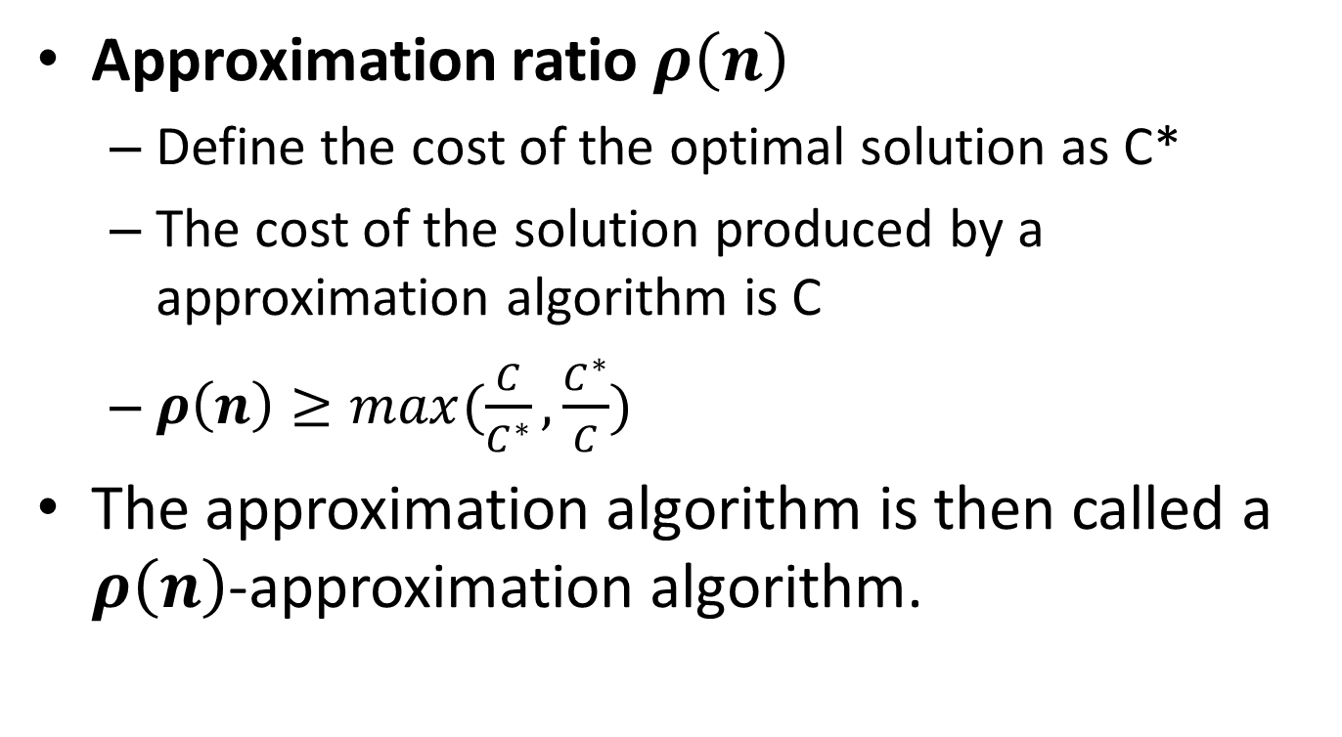
Approximation algorithms for NPC problems

Slide 5
Approximation algorithms for NPC problems
E.g.:
If the total weigh of a MST of graph G is 20
A algorithm can produce some spanning trees, and they are not MSTs, but their total weights are always smaller than 25
What is the approximation ratio?
25/20 = 1.25
This algorithm is called?
A 1.25-approximation algorithm

Slide 6
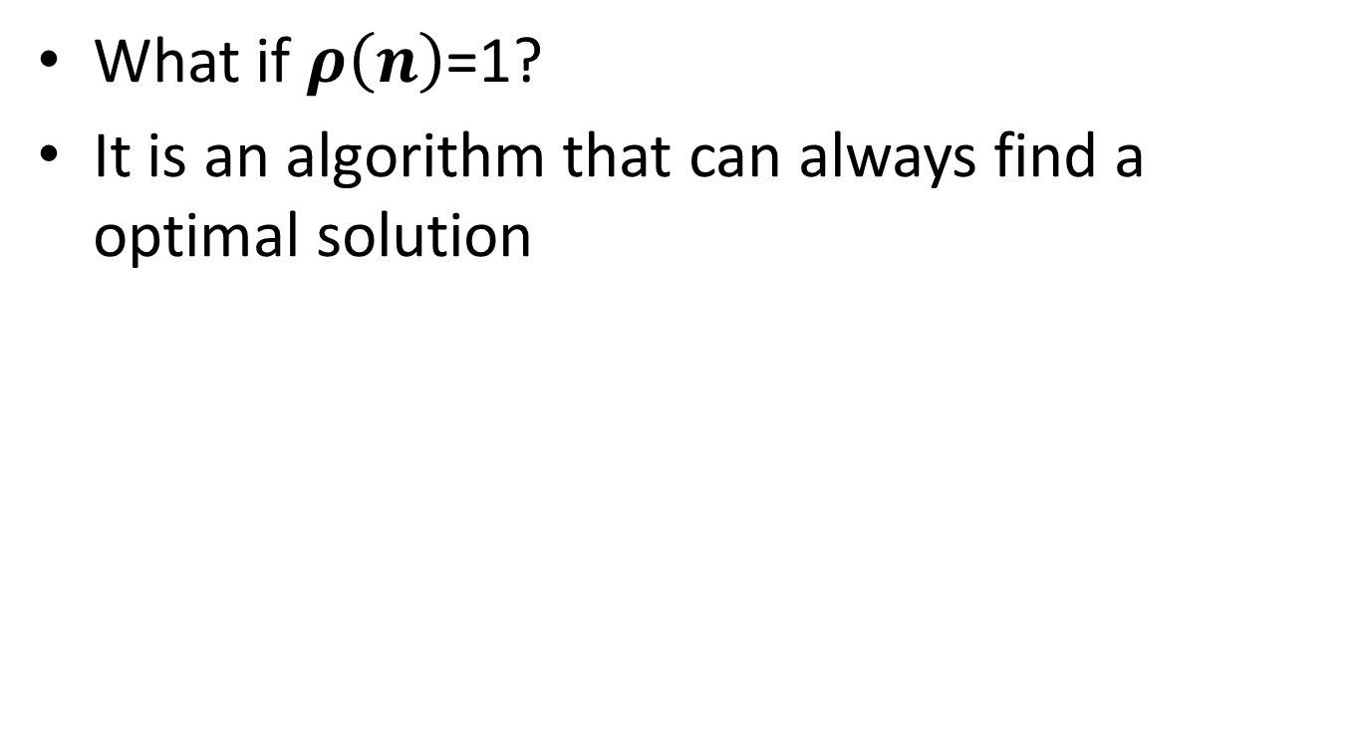
Approximation algorithms for NPC problems

Slide 7
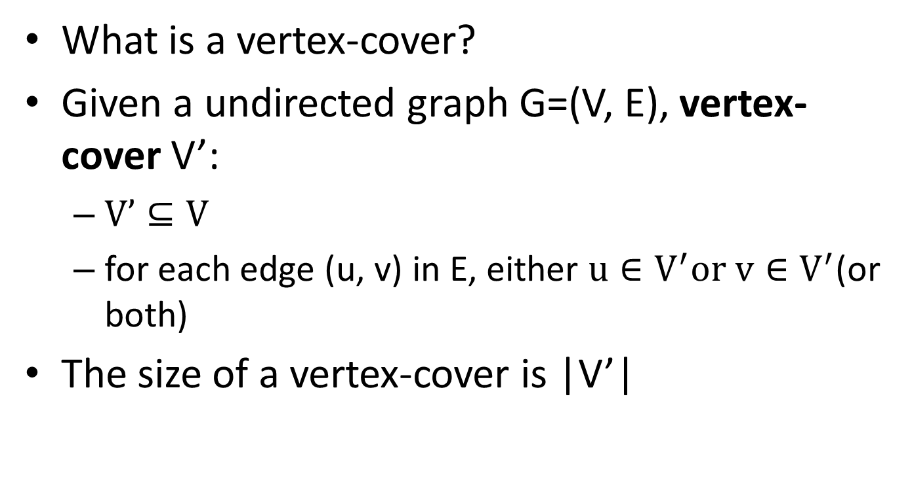
Vertex-cover problem and a 2-approximation algorithm

Slide 8
Vertex-cover problem and a 2-approximation algorithm
1
2
3
4
5
6
7
Are the red vertices a vertex-cover?
No. why?
Edges (3,5), (5, 6), (3, 6) and (3, 7) are not covered by it

Slide 9
Vertex-cover problem and a 2-approximation algorithm
1
2
3
4
5
6
7
Are the red vertices a vertex-cover?
Yes
What is the size?
4

Slide 10
Vertex-cover problem and a 2-approximation algorithm
1
2
3
4
5
6
7
Are the red vertices a vertex-cover?
Yes
What is the size?
7

Slide 11
Vertex-cover problem and a 2-approximation algorithm
1
2
3
4
5
6
7
Are the red vertices a vertex-cover?
Yes
What is the size?
3

Slide 12
Vertex-cover problem and a 2-approximation algorithm
Vertex-cover problem
Given a undirected graph, find a vertex cover with minimum size.
We don’t know how to find an optimal vertex cover in a graph G in polynomial time.
We can efficiently find a vertex cover that is near-optimal.

Slide 13
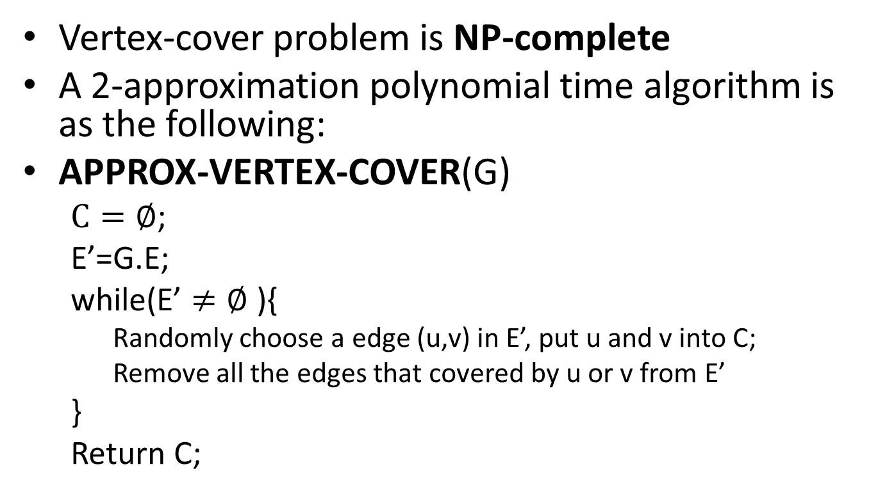
Vertex-cover problem and a 2-approximation algorithm
// Initializes C (vertex cover) to the empty set.
// E' copy of the edge set G.E of the graph.

Slide 14
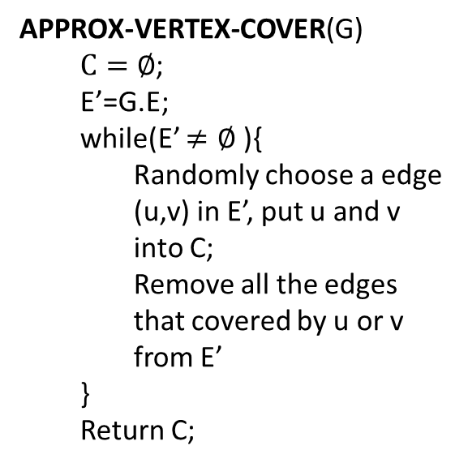
Vertex-cover problem and a 2-approximation algorithm
1
3
1
2
3
2
4
5
6
7
5
6
7

Slide 15
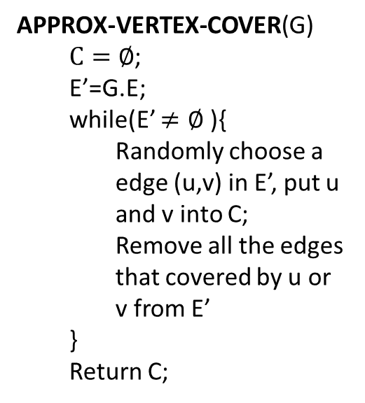
Vertex-cover problem and a 2-approximation algorithm
1
2
3
4
5
6
7
It is then a vertex cover
Size?
6
How far from optimal one?
Max(6/3, 3/6) = 2

Slide 16
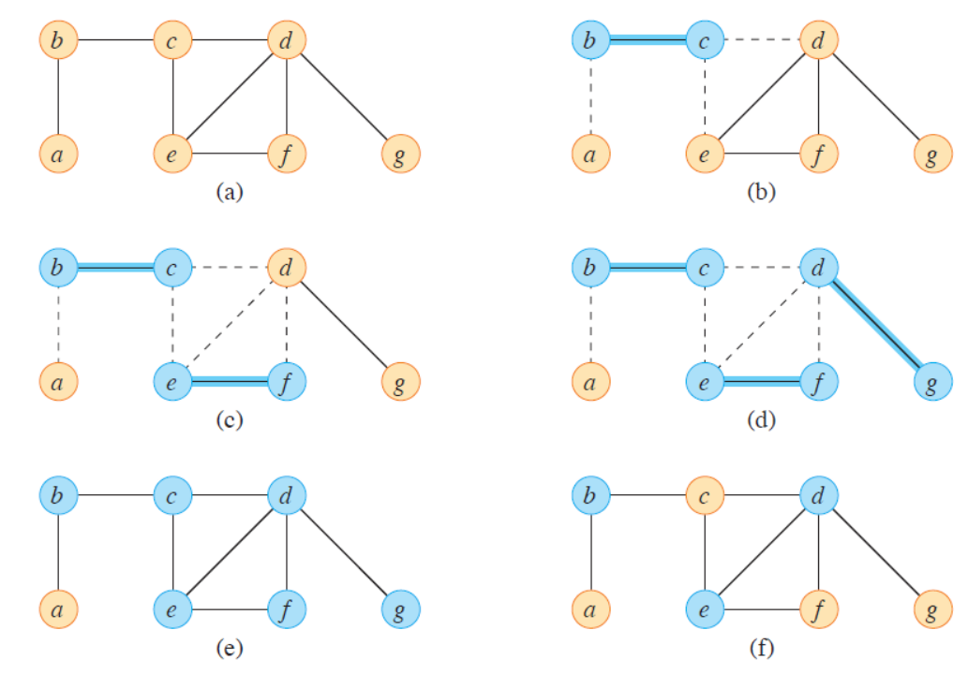
Vertex-cover problem and a 2-approximation algorithm
Found vertex cover : b, c, d , e, f, g.
Optimal vertex cover : b, d , e.

Slide 17
Vertex-cover problem and a 2-approximation algorithm
1
1
2
2
3
3
C = { },
E’ = {(1,2), (1,4), (2,3), (2,5), (3,5), (3,6), (3,7), (5,6)}
4
5
5
6
7
C = { 1,2 },
E’ = {(3,5), (3,6), (3,7), (5,6)}
C = { 1,2, 3, 5 },
E’ = { }

Slide 18
Vertex-cover problem and a 2-approximation algorithm
1
2
3
4
5
6
7
It is then a vertex cover
Size?
4
How far from optimal one?
Max(4/3, 3/4) = 1.33

Slide 19
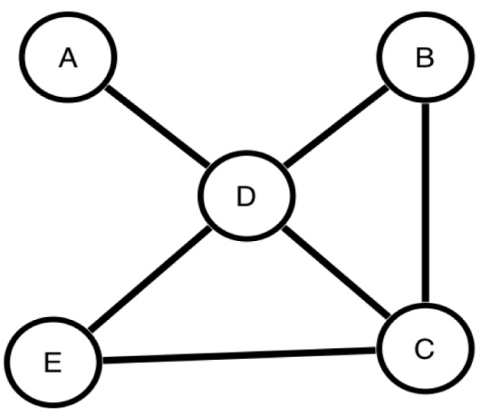
Applications of Vertex Cover Problem (VC)
Minimum Vertex Cover (MVC) problem comes into play in scheduling problems.
A scheduling problem can be modeled as a graph, where the vertices represent tasks or times, and an edge between vertices means that a conflict exists between those times or tasks.
Finding the minimum number of tasks that needs to be removed in order to resolve all conflicts is equivalent to finding a minimum vertex cover.
[Carruthers, Sarah, Ulrike Stege, and Michael Masson. "Human performance on hard non-Euclidean graph problems: Vertex cover." (2012).]

Slide 20
Vertex-cover problem and a 2-approximation algorithm
APPROX-VERTEX-COVER(G) is a 2-approximation algorithm
When the size of minimum vertex-cover is s
The vertex-cover produced by APPROX-VERTEX-COVER is at most 2s

Slide 21
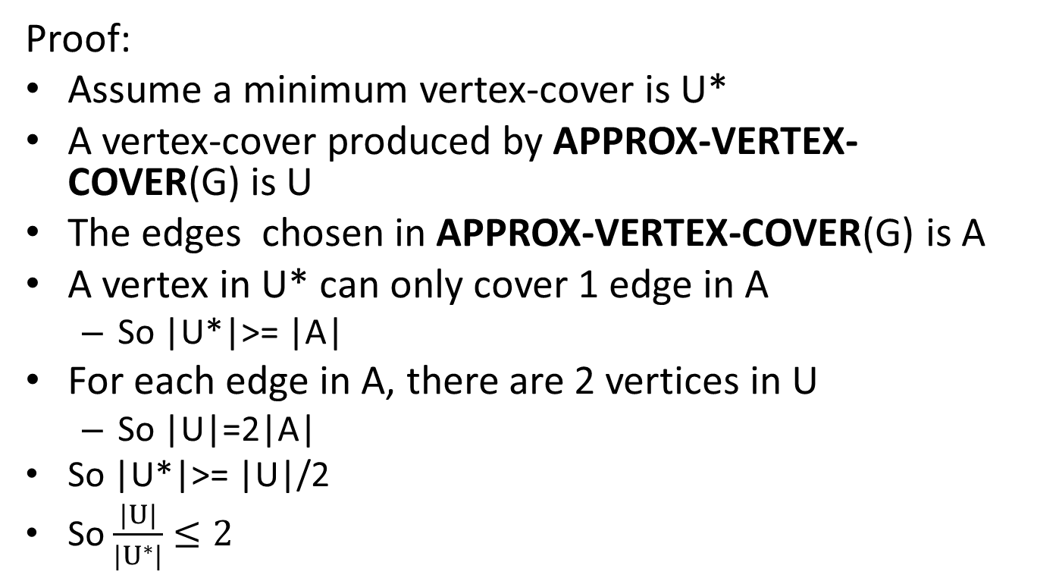
Vertex-cover problem and a 2-approximation algorithm

Slide 22
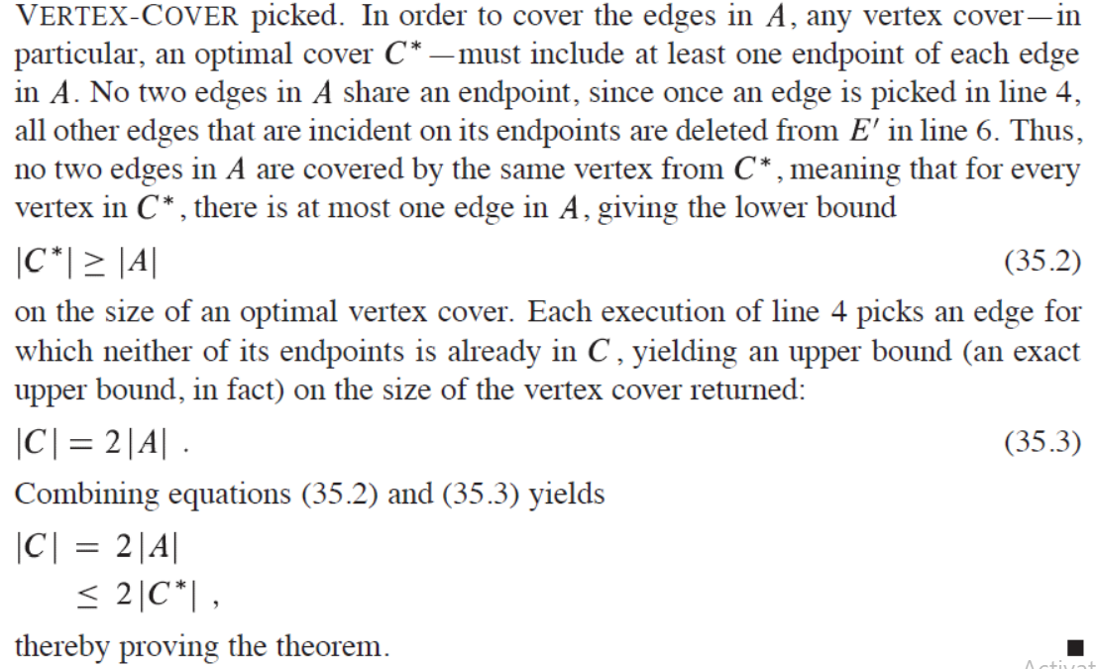
Vertex-cover problem and a 2-approximation algorithm

Slide 23
Traveling-salesman problem
Traveling-salesman problem (TSP):
Given a weighted, undirected graph with V >= 3, start from certain vertex, find a minimum route visit each vertices once, and return to the original vertex.
1
1
2
30
2
1
20
3
4
3

Slide 24
Traveling-salesman problem
Consider a salesperson wishes to make a tour, or hamiltonian cycle, visiting each city exactly once and finishing at the starting city. His goal is to find a tour that causes him to travel as little total distance as possible. (NP-Hard Version)
The general traveling salesman instance asks for an algorithm to find the optimal tour for all possible instances.
Here is a decision version of the Traveling Salesman Problem.
Given a set of distances on n cities, and a bound D, is there a tour of length at most D? (NP-Complete Version)
1
4
2
1
TSP minimum-cost tour, with cost 7.
3
2
1
3
4
5

Slide 25
Traveling-salesman problem
TSP is a NP-complete problem
There is no polynomial-time approximation algorithm with a constant approximation ratio
Another strategy to solve NPC problem:
Solve a special case

Slide 26
Traveling-salesman problem
Triangle inequality:
Weight(u, v) <= Weight(u, w) + Weight(w, v)
E.g.:
If all the edges are defined as the distance on a 2D map, the triangle inequality is true
For the TSPs where the triangle inequality is true:
There is a 2-approximation polynomial time algorithm

Slide 27
Metric TSP
Metric TSP is an special case of the TSP that satisfies the triangle inequality.
Each vertex should be connected with every other vertex.

Slide 28
Traveling-salesman problem
APPROX-TSP-TOUR(G)
Minimum Spanning Tree;
Creating a Cycle;
Removing Redundant Visits;

Slide 29
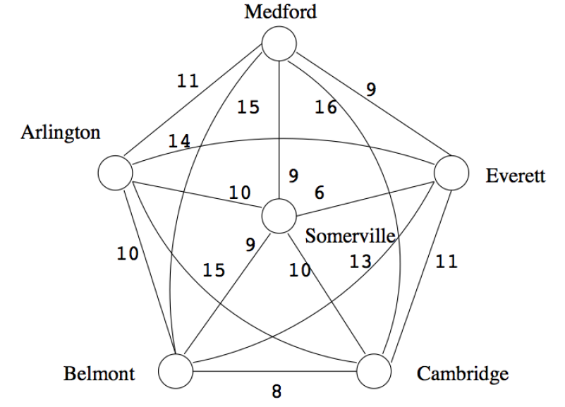
Metric TSP

Slide 30
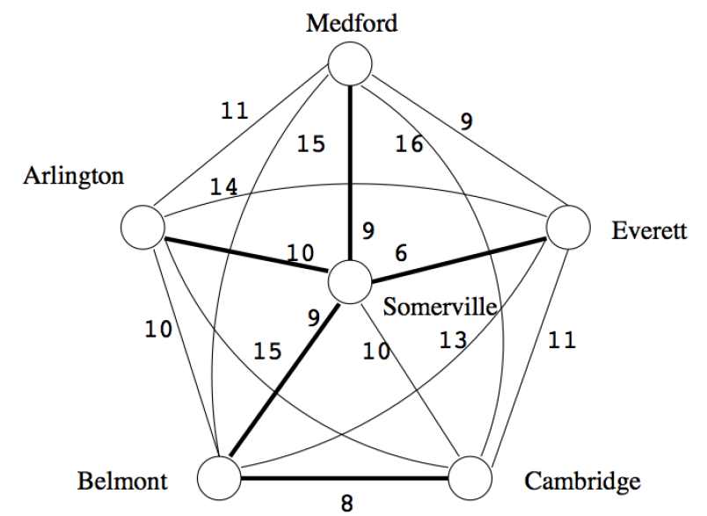
Step 1: MST

Slide 31
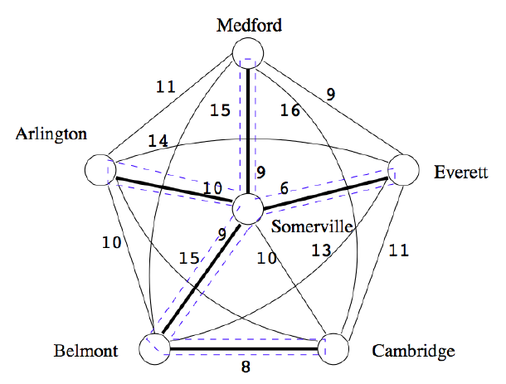
Step 2: Creating a cycle - using DFS
S → M → S → E → S → B →
C → B → S → A → S
S → M → S → E → S → B →
C → B → S→ A → S
X
X
X
X

Slide 32
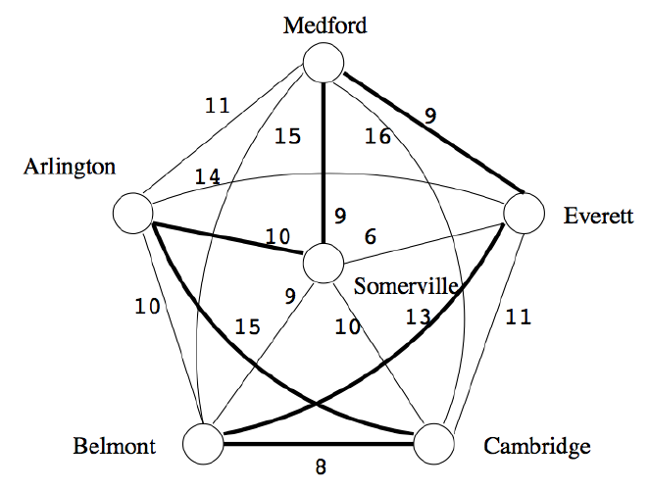
Step 3: Removing Redundant Visits of DFS
S,M,E,B,C,A,S with weight 64

Slide 33
2 Approximation Algorithm
Claim: The weight of the MST M is less than OPT, the weight of the TSP solution T.
Take T and remove an edge e. T is now a spanning tree.
Because M is the MST,
w(M) ≤ w(T−e)
w(M) ≤ w(T)−w(e)
w(M) ≤ OPT−w(e)
Therefore, w(M) < OPT.
Because each edge is used exactly twice during a depth first search on a tree (once descending, once ascending)
w(W) = 2 * w(M) < 2 * OPT.
// Weight of MST w(M) less than original TSP cycle bcoz MST has 1 less edge
≤

Slide 34
Traveling-salesman problem
Can we apply the approximation algorithm on this one?
1
1
2
30
2
1
20
3
4
3
No. The triangle inequality is violated.

Slide 35
Traveling-salesman problem (Method 2)
APPROX-TSP-TOUR(G)
Find a MST m;
Choose a vertex as root r;
return preorderTreeWalk(m, r);

Slide 36
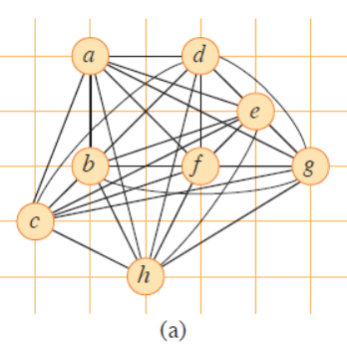
Traveling-salesman problem (Method 2)

Slide 37
Traveling-salesman problem (Method 2)
Use Prim’s algorithm to get a MST
a
d
e
b
f
g
c
h
For any pair of vertices, there is a edge and the weight is the Euclidean distance
Triangle inequality is true, we can apply the approximation algorithm

Slide 38
Traveling-salesman problem (Method 2)
Use Prim’s algorithm to get a MST
a
d
Choose “a” as the root
e
b
f
g
Preorder tree walk
c
a
b
c
h
d
e
f
g
h
For any pair of vertices, there is a edge and the weight is the Euclidean distance
Triangle inequality is true, we can apply the approximation algorithm

Slide 39
Traveling-salesman problem (Method 2)
Use Prim’s algorithm to get a MST
a
d
Choose “a” as the root
e
Preorder tree walk
a, b; c; b; h; b; a; d; e; f; e; g; e; d; a
X
X
X
b
f
g
X
X
X
X
c
a
b
c
h
d
e
f
g
h
Because it is a 2-approximation algorithm
The route is then…
A TSP solution is found, and the total weight is at most twice as much as the optimal one
The full walk of our example gives the order a; b; c; b; h; b; a; d; e; f; e; g; e; d; a :
Since the full walk traverses every edge of T exactly twice,

Slide 40
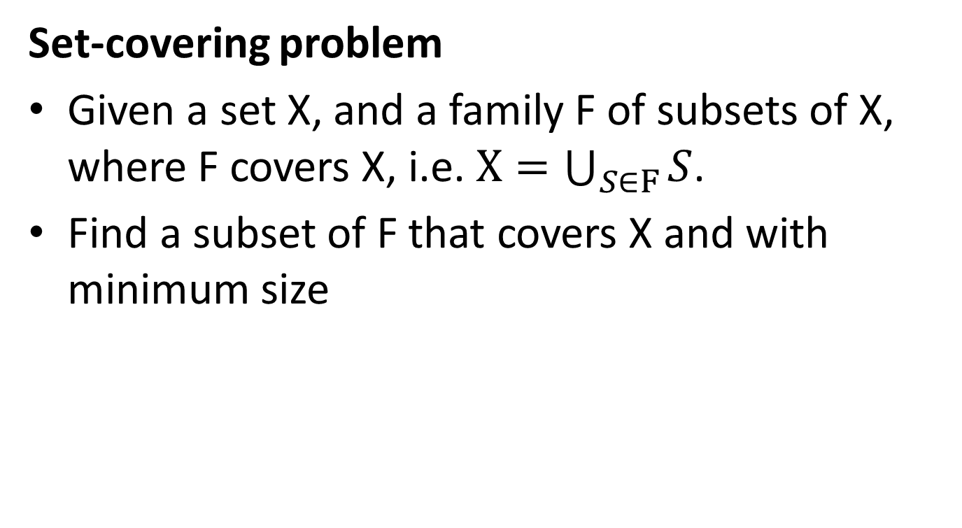
The set-covering problem

Slide 41
The set-covering problem
X:
a
b
c
h
d
e
{f1, f3, f4} is a subset of F covering X
F:
{f1, f2, f3, f4} is a subset of F covering X
f1:
a
b
f5:
a
{f2, f3, f4, f5} is a subset of F covering X
f2:
b
f3:
c
h
Here, {f1, f3, f4} is a minimum cover set
f4:
d
e

Slide 42
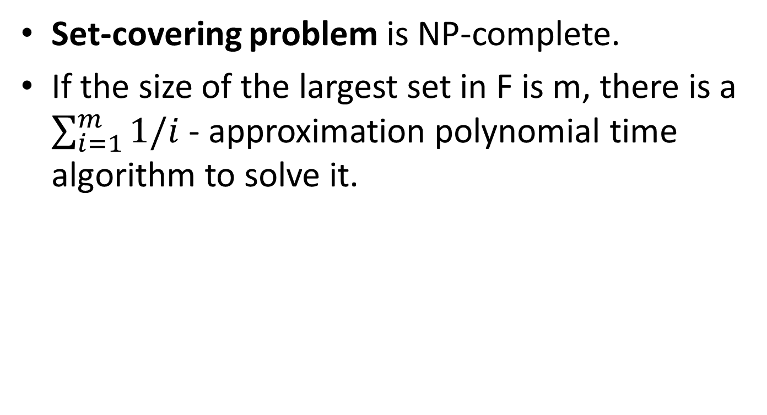
The set-covering problem

Slide 43
The set-covering problem
We can choose from f1, f3 and f4
X:
Choose f1
a
b
c
h
We can choose from f3 and f4
Choose f3
We can choose from f4
d
e
Choose f4
F:
f1:
a
b
a
b
c
h
d
e
U:
f2:
b
f3:
c
h
C:
f1:
a
b
f3:
c
h
f4:
d
e
f4:
d
e
f5:
a

Slide 44
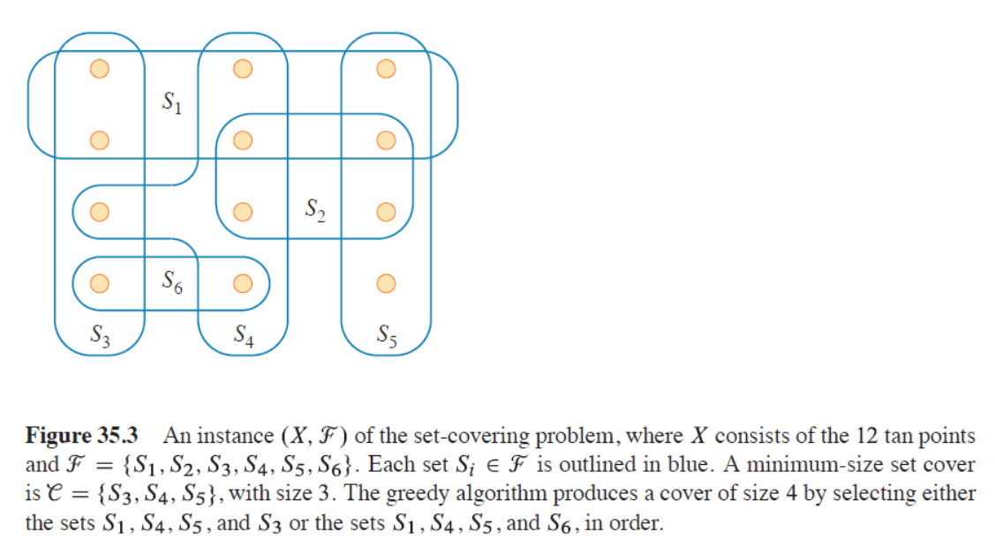
The set-covering suboptimal example

Slide 45
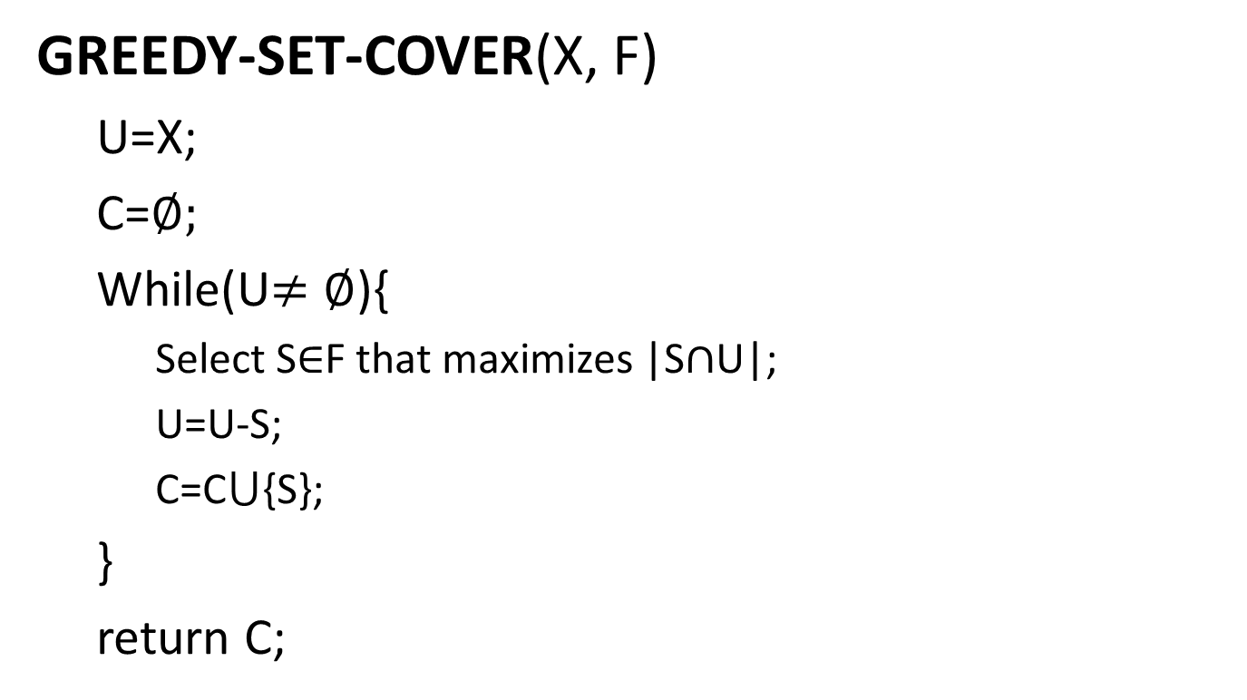
The set-covering problem
// The set U contains, the set of remaining uncovered elements.
// The set C contains the cover being constructed.
// choosing a subset S that covers as many uncovered elements as possible.
// removes elements covered by set S from U.
// places S into C.

Slide 46
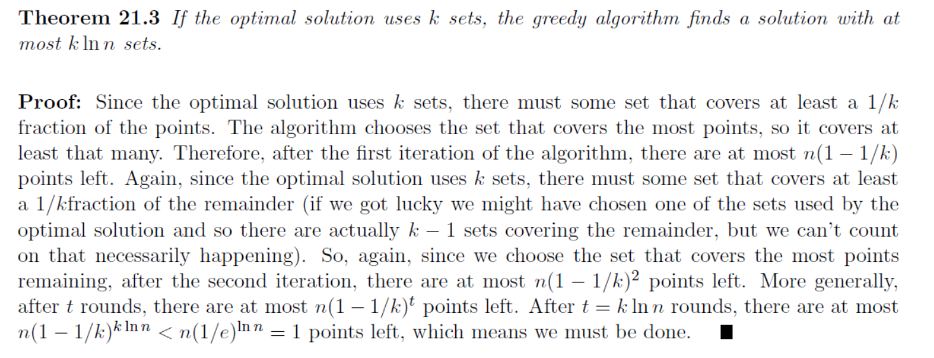
The set-covering problem

Slide 47
